Slide 1



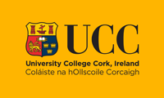







Research Managers as Architects of Impact: Strengthening the Profession through CARDEA
All-Island Research Culture Network's 2025 Conference
Dr Olivia O’Leary, Project Manager
Veronique Larosa & Laurence Maquest
(CARDEA Communications team)
The CARDEA project is funded by the European Union. Views and opinions expressed are however those of the author(s) only and do not necessarily reflect those of the European Union or the European Research Executive Agency (REA). Neither the European Union nor REA can be held responsible for them.

Slide 2

CARDEA
Ancient Roman Goddess of the Hinge
Research Managers open Research Doors

Slide 3
What it stands for
Career Acknowledgement for Research Managers Delivering for the European Area

Slide 4



Who are we?
Mostly HR professionals and those interested in Research Careers
Pan-European Consortium representing 8 EU countries
Led by UCC

Slide 5





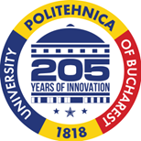



GREECE
BELGIUM
CROATIA
ITALY
POLAND
ROMANIA
SPAIN
IRELAND

Slide 6

What is our objective?
Professionalisation of Research Management as a valued career choice with:
identified competencies
Progression pathways
Standards for benchmarked and indexed salaries
Access to appropriate skills development through a transnational Research Management Hub

Slide 7

What do Research Managers Want? (CARDEA Survey)
Career Visibility
A Competency Framework inclusive of training
Promotional Framework
Definition of the Role of Research Manager

Slide 8




Thanks to Action 17
What have we delivered?
Career Visibility
A Competency Framework inclusive of training
Promotional Framework
Definition of the Role of Research Manager

Slide 9

RM Comp
Cognitive Abilities/Personal Attributes
Subject Matter Expertise/Specialised Knowledge
7 Main Competence Areas
Research Manager
Research Project Oversight
Technical Proficiency
European Research Manager Competency Framework
Line Management and Talent Development
Stakeholder Engagement
Communication

Slide 10
What is included in RM Comp?
7 Main Competence Areas
50 Competencies
800 Learning Outcomes

Slide 11

Learning Outcomes
800
learning outcomes along
4 proficiency levels
(foundational, intermediate, advanced, expert)

Slide 12

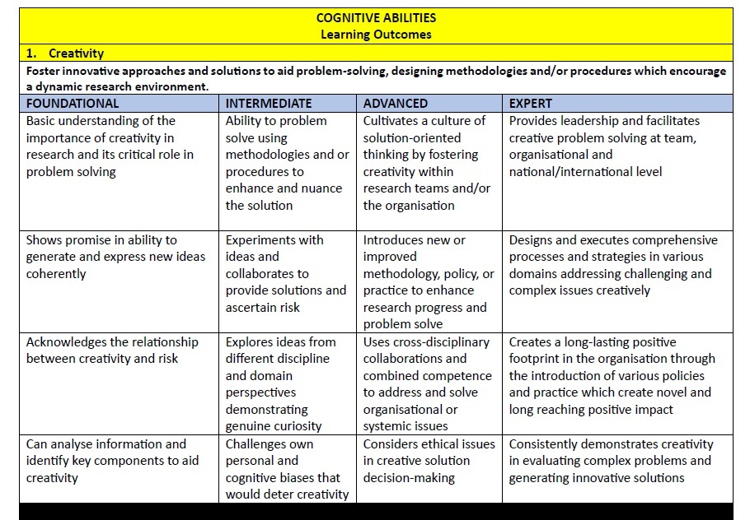

Learning Outcomes

Slide 13

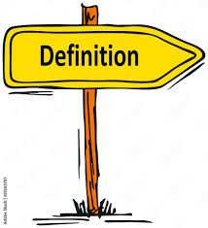
RM Comp Objectives
Goal - Simple
Goal - Interoperable
Goal - Consistent
Goal - Transparent
Goal - For all Research Managers

Slide 14

Research Managers
RM4
Research Manager 4:
Senior Stage Research Manager
RM3
Research Manager 3:
Established Research Manager
RM2
Research Manager 2:
Recognised Research Manager
RM1
Research Manager 1:
First Stage Research Manager

Slide 15
Important to note!!!!
The European Career Framework for Research Managers (RM 1 to RM 4) is a progression model framework and operates independently of the European Competency Framework RM Comp.

Slide 16
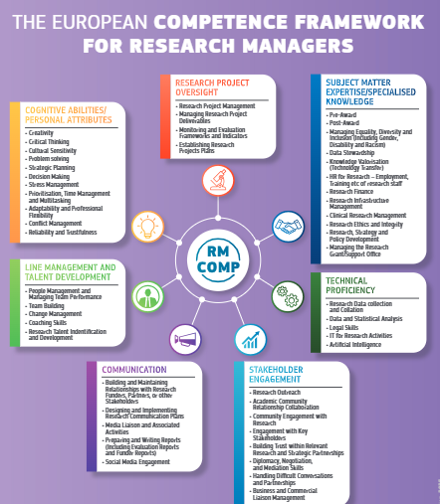
The European Competence Framework for Research Managers
It’s for:
Research Managers (Individuals): Whether early-career or advanced, RM Comp helps identify career paths, skill gaps and training needs.
Institutions: Public and private research-performing organisations employing research managers, aiming to standardise practices and enable staff development.
Research Funding Bodies and Policy advisors: Ensures consistency of funding policies, promotes capacity building and facilitates collaboration across sectors.

Slide 17
How to Use RM Comp?
Individual Research Managers:
Self-Assessment: Identify your current skills and areas for improvement using the RM Comp framework.
Professional Development: Use the outlined competencies to plan training or mentorship opportunities.
Daily Application: Align your work practices with RM Comp standards to improve efficiency and collaboration.
Research Performing Organisations and Industry:
Integrate RM Comp into Policies: Embed it in hiring processes (e.g., job specifications), training programs, and performance reviews.
Enable Staff Development: Provide RM Comp-aligned resources, platforms, and budgets (where possible) for professional growth.
Monitor Impact: Use RM Comp to track the effectiveness of research management practices and identify gaps.
Funding Agencies and Policy Advisors:
Set Standards: Use RM Comp competencies as criteria for funding applications and evaluations.
Promote Capacity Building: Fund training programs and conferences focused on RM Comp skills.
Facilitate Collaboration: Work with institutions to develop RM Comp-aligned policies and share best practices.

Slide 18
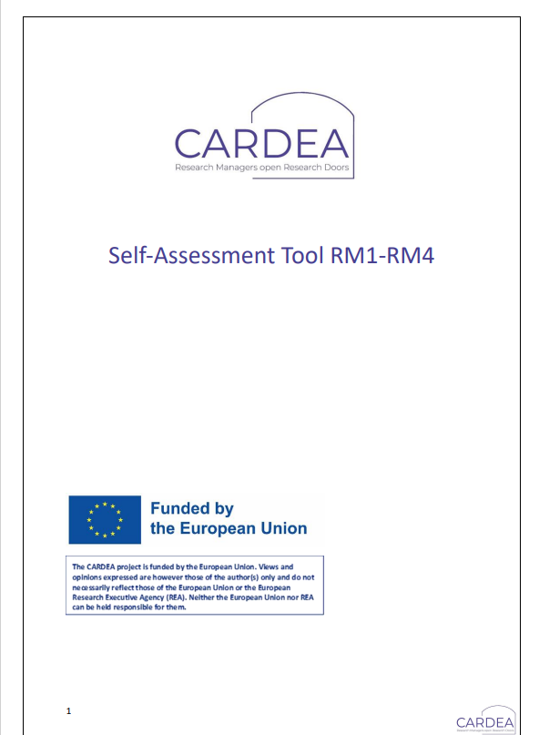
Professional Development Tool-Kit
Free Downloadable Tool-kit on CARDEA Hub
Knowledge, Skills, Abilities (KSA) Self-Assessment Tool:
Training Needs Analysis—Guided Assessment Tool
Professional Development Plan for RMs – Template
Mentoring workbook
Reflective Toolkit

Slide 19
Knowledge Skills Abilities (KSA) Self-Assessment Tool: This tool empowers RMs to conduct a self-assessment of their knowledge, skills, and abilities. By identifying areas for improvement, RMs can tailor their professional development efforts.
Mentoring workbook: is a structured guide designed to facilitate effective mentoring relationships within the research management community.
Professional Development Plan Workbook: This provides a structured format for RMs to plan their professional development. It includes sections for setting career goals, identifying required skills and training, and tracking progress
Training Needs Analysis Guided Assessment Tool: Designed for both individual RMs and organisations, these tool guide users through a structured assessment of training needs.
Reflective Toolkit: is a resource aimed at encouraging RMs (RMs) to engage in continuous self-reflection as part of their professional development.

Slide 20
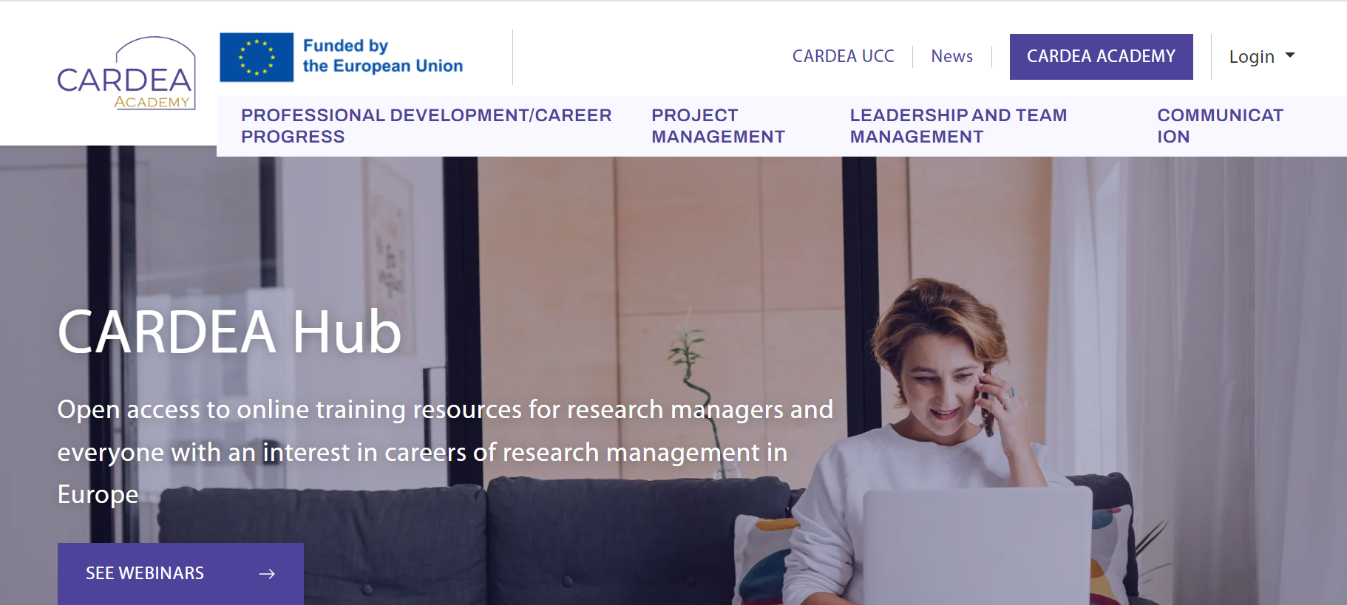
The CARDEA Hub: Home of the CARDEA ACADEMY

Slide 21
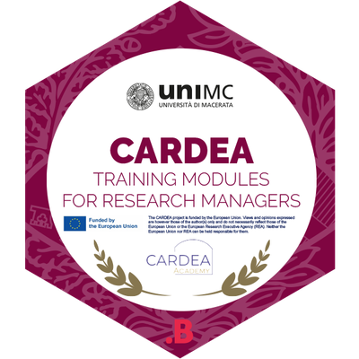
The Cardea European Research Manager’s Hub (CERMH) as a transnational platform for collaboration, networking, training, knowledge sharing, policy development, and continuous improvement.
The Hub will serve the multiple needs of the multiple stakeholders in this multi-disciplinary profession. The purpose of the Hub is to provide a virtual space for stakeholders to come together in the spirit of collaboration, co-creation, and knowledge sharing.
It will embrace:
Networking and mobility activities
Training and development opportunities and
Policy development, best practice guidelines and policy dissemination.
Free Micro-credential Training in the CARDEA Academy
Professional Development and Training Opportunities
Designed by Research Managers for Research Managers

Slide 22

LEARNING OBJECTIVE:
Provide training for RMs covering all competence areas of the profession
CONTENT:
CARDEA training modules are core learning common to all categories of RMs (i.e., Data Manager, Research Project Manager, Research Integrity Manager, and Outreach Manager), a comprehensive training covering the main aspects of the research management profession.
  COVER ALL 8 COMPETENCE AREAS of RM COMP with a FOCUS ON SUBJECT MATTER EXPERTISE (Specialised knowledge for research performing organisational contexts).
TARGET:
mainly people new to the profession (RM1 newcomers), but training will also be valuable for more expert staff (RM2, RM3 and RM4) who could choose some topics according to their own needs.
*FOCUS ON FOUNDATIONAL LEVEL COMPETENCES OF RM COMP
Designed by Research Managers for Research Managers

Slide 23
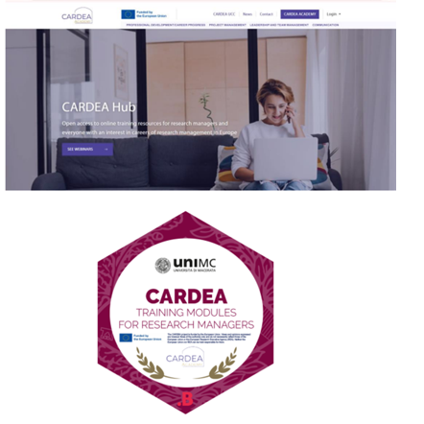
Main Features Of CARDEA Training Modules
Recorded lessons format (without live audience) created specifically for the CARDEA training purpose.
In English language.
Free.
17 modules: 2 hours per each module: a module is divided into several sub-videos lasting 20/30 minutes each for one "2hcourse“.
Trainers: CARDEA partners + external expert.
CARDEA will release a micro-credential for free to those who will complete the CARDEA training modules entirely.

Slide 24

What’s Next for CARDEA?
Charter for Research Managers
Research Manager Mobility
EDI
Capacity Building
**Please connect with us we’d love to get to know you ☺

Slide 25
What it’s like to work together in the CARDEA consortium?
🌍 Cultural Diversity:Working with partners from different countries brings fresh perspectives and new ways of thinking.
💬 Exchange & Mutual Learning: Each meeting is an opportunity to share practices, Tools, and approaches.
🤝 Inclusive & collaborative management: UCC fosters an open and inclusive atmosphere where everyone’s input is valued.
🌱 Personal and professional growth: Participating in the consortium has enriched our own way of working and has expanded our horizons.

Slide 26

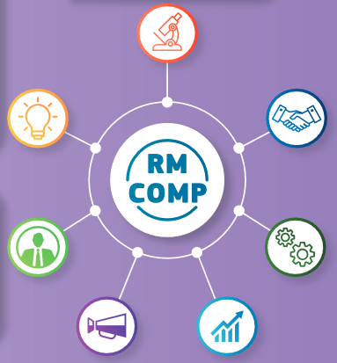

Join us for our RM COMP webinar
06/06/2025 – 10 am CET
Empowering Research Managers
Subscribe here

Slide 27

Thank You Please connect with us ☺
The CARDEA project is funded by the European Union. Views and opinions expressed are however those of the author(s) only and do not necessarily reflect those of the European Union or the European Research Executive Agency (REA). Neither the European Union nor REA can be held responsible for them.

